Slide 1
Data Visualization
Saryu Onishi
HES 3000-002, Sport Performance Analytics

Slide 2
Why visualization matters in sports analytics

Slide 3
Why visualization matters in sports analytics
Pattern recognition and speed
Communication and decision support
Notes:
Sports data visualization is described as an increasingly important research direction
Visual processing happens faster than numerical processing—critical for time-sensitive sports decisions

Slide 4
Who played the most minutes?
Player | Pos | GP | GS | Mins
T. Baribo | F | 29 | 20 | 1876
B. Damiani | F | 33 | 23 | 2040
M. Uhre | F | 29 | 16 | 1325
I. Vassilev | M | 31 | 21 | 1973
D. Jean Jacques | M | 31 | 26 | 2361
K. Wagner | D | 32 | 30 | 2769
Q. Sullivan | M | 28 | 24 | 1967
N. Harriel | D | 25 | 23 | 2098
M. Iloski | F | 9 | 7 | 600
D. Gazdag | M | 6 | 6 | 498
J. Lukic | M | 32 | 30 | 2620
O. Makhanya | D | 29 | 23 | 2145
A. Bedoya | M | 24 | 9 | 739
J. Glesnes | D | 31 | 30 | 2626
F. Westfield | D | 25 | 18 | 1724
I. Glavinovich | D | 4 | 3 | 257
M. Anderson | F | 3 | 1 | 98
J. Bueno | M | 20 | 11 | 903
N. Pierre | D | 1 | 0 | 20
D. Vazquez | M | 1 | 0 | 19
O. Mbaizo | D | 9 | 6 | 481
C. Sullivan | M | 11 | 1 | 214
J. Rafanello | M | 15 | 2 | 274
S. Olivas | F | 3 | 0 | 45
B. Bender | M | 7 | 4 | 320
A. Rick | G | 14 | 13 | 1232
E. Davis | F | 1 | 0 | 2
A. Blake | G | 21 | 21 | 1828
C. Donovan | F | 20 | 6 | 540
Notes:
Who played the most minutes?

Slide 5
Gradient to represent magnitude

Slide 6
Order to organize values

Slide 7
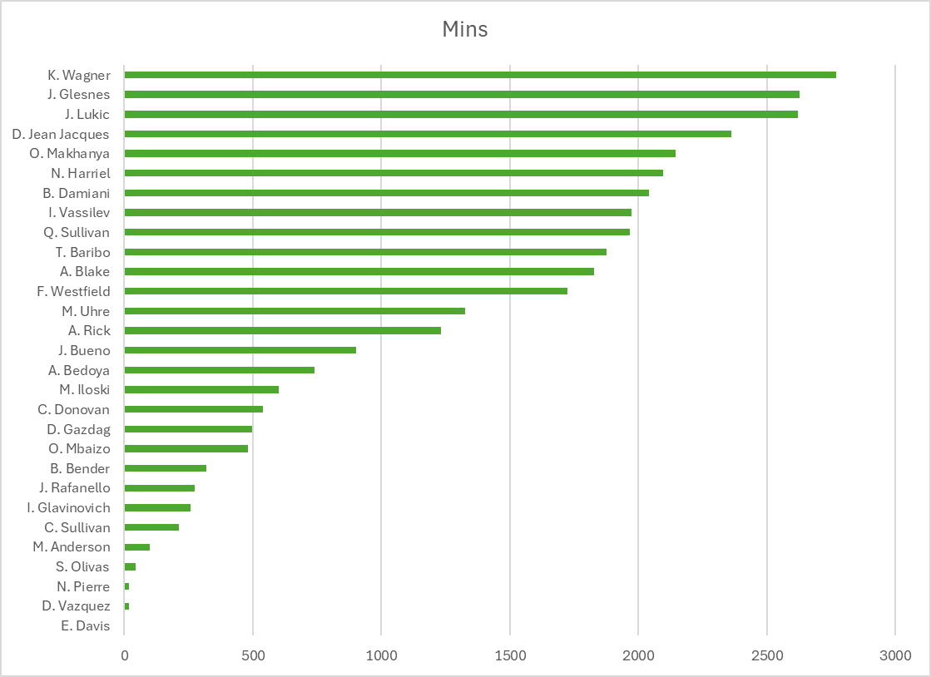
Visual representation of values

Slide 8
Why visualization matters in sports analytics
Pattern recognition and speed
Communication and decision support
Notes:
Sports data visualization is described as an increasingly important research direction
Visual processing happens faster than numerical processing—critical for time-sensitive sports decisions

Slide 9
Who played >1500 minutes last season?
Player | Pos | GP | GS | Mins
T. Baribo | F | 29 | 20 | 1876
B. Damiani | F | 33 | 23 | 2040
M. Uhre | F | 29 | 16 | 1325
I. Vassilev | M | 31 | 21 | 1973
D. Jean Jacques | M | 31 | 26 | 2361
K. Wagner | D | 32 | 30 | 2769
Q. Sullivan | M | 28 | 24 | 1967
N. Harriel | D | 25 | 23 | 2098
M. Iloski | F | 9 | 7 | 600
D. Gazdag | M | 6 | 6 | 498
J. Lukic | M | 32 | 30 | 2620
O. Makhanya | D | 29 | 23 | 2145
A. Bedoya | M | 24 | 9 | 739
J. Glesnes | D | 31 | 30 | 2626
F. Westfield | D | 25 | 18 | 1724
I. Glavinovich | D | 4 | 3 | 257
M. Anderson | F | 3 | 1 | 98
J. Bueno | M | 20 | 11 | 903
N. Pierre | D | 1 | 0 | 20
D. Vazquez | M | 1 | 0 | 19
O. Mbaizo | D | 9 | 6 | 481
C. Sullivan | M | 11 | 1 | 214
J. Rafanello | M | 15 | 2 | 274
S. Olivas | F | 3 | 0 | 45
B. Bender | M | 7 | 4 | 320
A. Rick | G | 14 | 13 | 1232
E. Davis | F | 1 | 0 | 2
A. Blake | G | 21 | 21 | 1828
C. Donovan | F | 20 | 6 | 540
Notes:
We need to flag athletes who played more than 1500 minutes

Slide 10
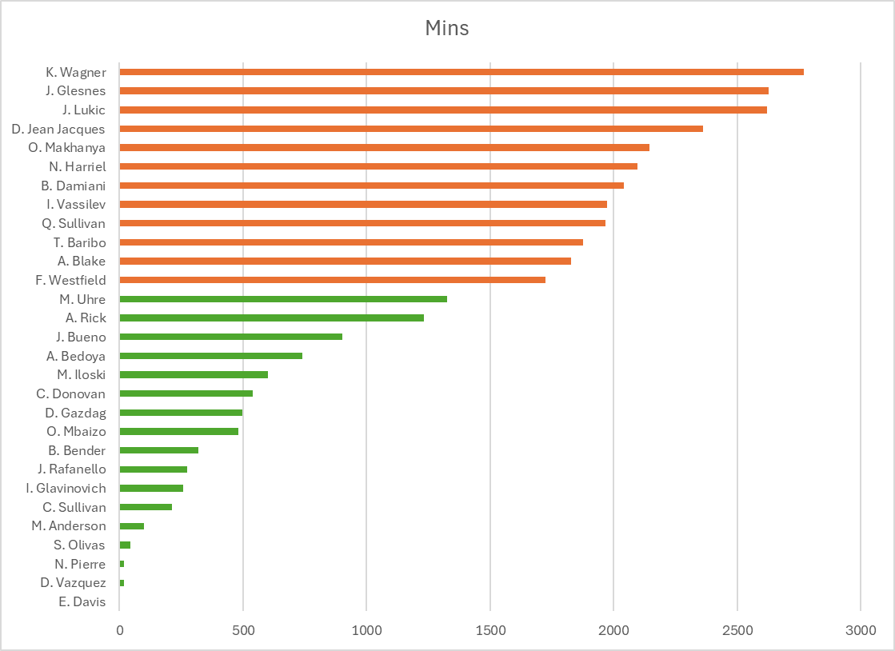
Color, order, graphs

Slide 11
Why visualization matters
Each version contained the same basic data. What changed was how the data were visually encoded.
Tables are useful for looking up exact values.
Charts are useful for seeing patterns.
Ordering improves comparison.
Color and reference lines add meaning.
Different visual choices support different decisions.

Slide 12
Directing attention

Slide 13
Visual encoding
Visual encoding maps data values to visual properties.
Attributes such as position, length, color, size and shape communicate different information.
vertical position = player name
bar length = minutes
reference line = decision threshold
color = above or below threshold

Slide 14
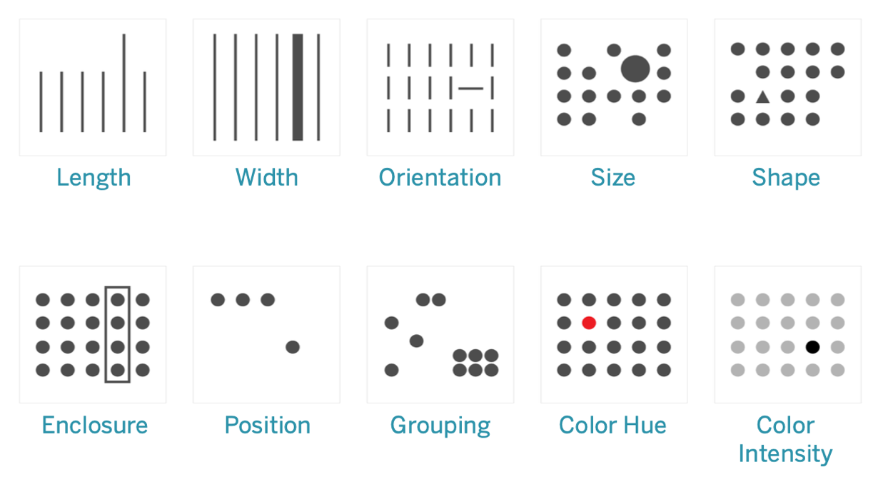
Pre-attentive attributes
Visual properties that the human brain processes almost instantly and subconsciously
Notes:
Visual properties your brain processes in <200-250 milliseconds You see them instantly without conscious effort
Happens before you "think" about what you're looking at
Critical for dashboards, in-game analytics, quick decision-making
Spatial:
length,
width,
orientation,
enclosure
position,
grouping,
Size
Shape
Color:
hue
intensity
Motion

Slide 15
Pre-attentive attributes
Visual properties that the human brain processes almost instantly and subconsciously
spatial
size and shape
color
Notes:
Visual properties your brain processes in <200-250 milliseconds You see them instantly without conscious effort
Happens before you "think" about what you're looking at
Critical for dashboards, in-game analytics, quick decision-making
Spatial:
length,
width,
orientation,
enclosure
position,
grouping,
Size
Shape
Color:
hue
intensity
Motion

Slide 16
Attention versus importance
Visual emphasis tells the audience where to look.
The most visually prominent element appears important.
Emphasis should reflect the analytical question.
Unnecessary emphasis can distort interpretation.

Slide 17
Accuracy in visualizations

Slide 18
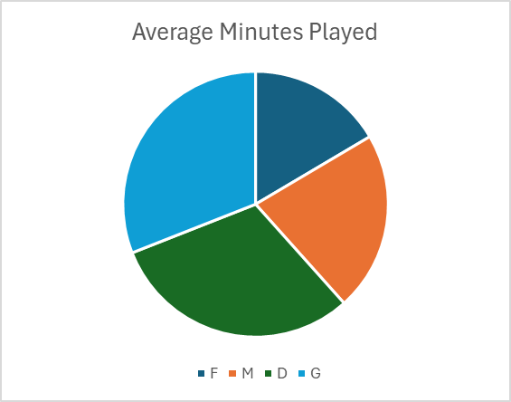
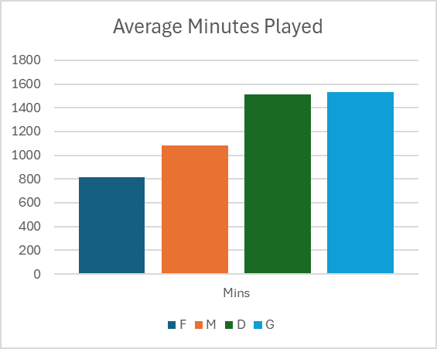
Making comparisons easy
Which position accumulated more minutes?
Approximately how many more minutes?

Slide 19
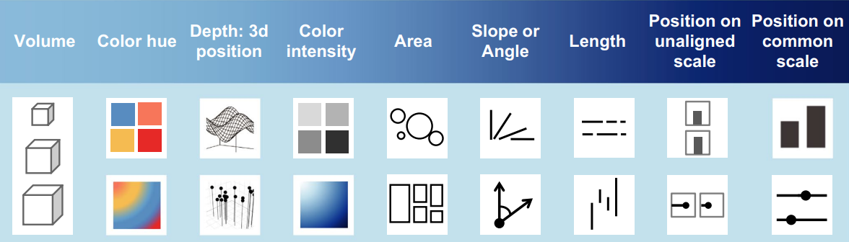
Accuracy of visual encodings

Slide 20
Accuracy of visual encodings

Slide 21
Selecting attributes

Slide 22
Selecting attributes
Which visual properties would appropriately represent:
  Position
  Minutes played
  Team
  Average sprint speed
Data type | Appropriate visual properties
Numerical | Length, size, color intensity
Nominal | Color hue, shape
Ordinal | Color intensity, size

Slide 23
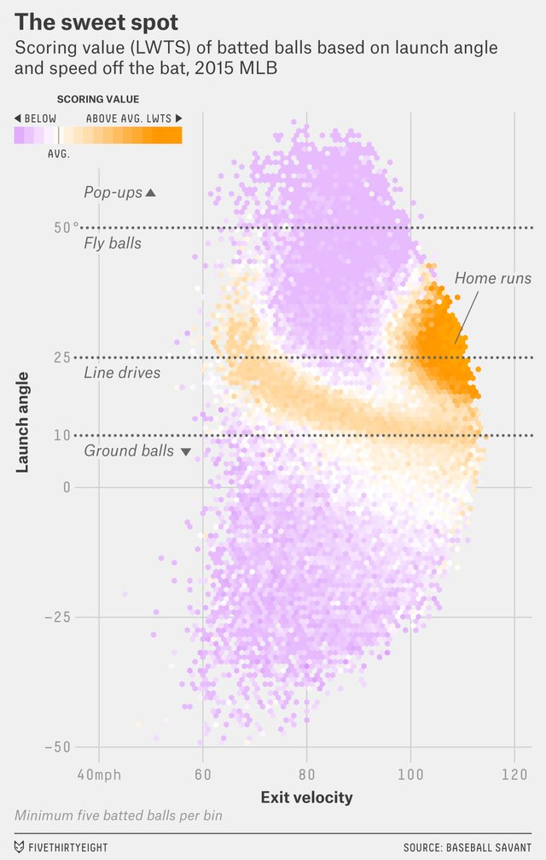
Identifying visual attributes
What visual attributes are used here?
Notes:
assigns a run value to each offensive event based on how much that event typically increases run scoring.
For example (approximate values):
Walk ≈ 0.7 runs
Single ≈ 0.9 runs
Double ≈ 1.2 runs
Triple ≈ 1.6 runs
Home run ≈ 2.0 runs

Slide 24
Choosing the Right Chart Type

Slide 25
Match the chart to your question
You would never do analysis before the question
Same ideas apply here
Research Question
Visualization Type
Visual Encoding Methods
Notes:
Chart types section → 10-15 slides (show the chart type + sports application for each)

Slide 26
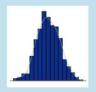

distribution
Histograms: Player height distribution, shot distance distribution
Density plots: Smoothed shooting ranges
Box plots: Comparing stat distributions across positions or teams
Violin plots: Showing full distribution shape (sprint speeds by position)

Slide 27
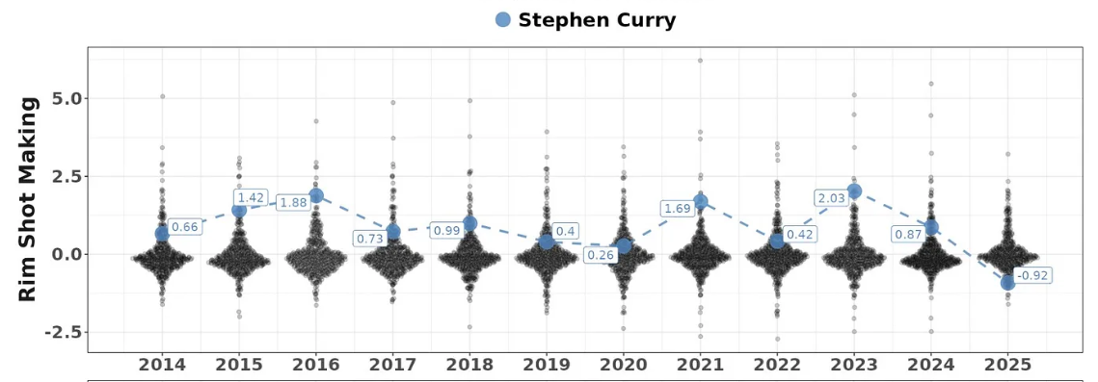
distribution
Histograms: Player height distribution, shot distance distribution
Density plots: Smoothed shooting ranges
Box plots: Comparing stat distributions across positions or teams
Violin plots: Showing full distribution shape (sprint speeds by position)

Slide 28
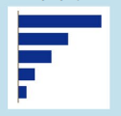

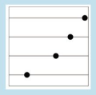
Comparisons (rank)
Bar charts: Simple stat comparisons (points per game by player)
Grouped/stacked bars: Multi-category comparisons (shooting % by zone)
Dot plots: Clean alternative to bars, especially for rankings
Radar/spider charts: Multi-dimensional player comparisons (use cautiously!)

Slide 29
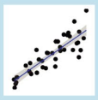
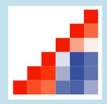
Relationships
Scatter plots: Exploring correlations (height vs. rebounding)
Correlation matrices: Multiple pairwise correlation
Hexbin plots: scatter plots with aggregation (shot charts)

Slide 30

Part-to-whole
Stacked bars: Composition of team offense (3PT vs. 2PT vs. FT)
Tree maps: Allocating playing time or usage
Pie charts: use cautiously

Slide 31
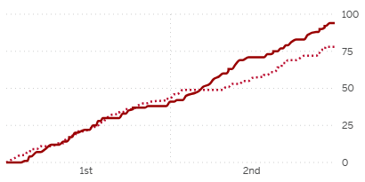
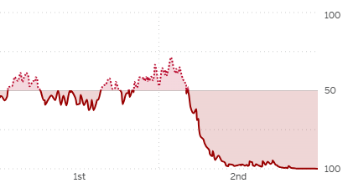
Time series
Line charts: Performance over season, in-game momentum
Area charts: Cumulative stats over time

Slide 32
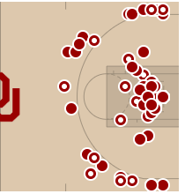
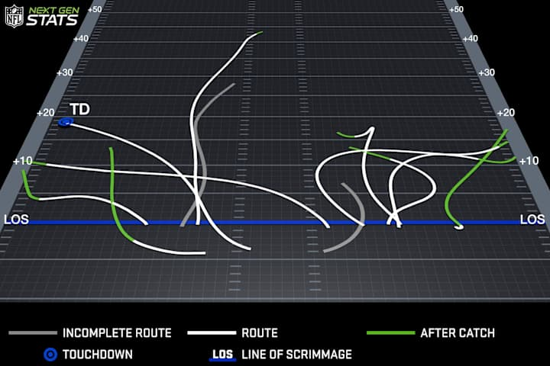
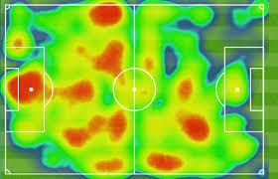
Spatial/Location data
Heat maps: Player positioning, shot locations
Contour plots: Density of activity on field/court
Field/court overlays: Context matters in sports

Slide 33
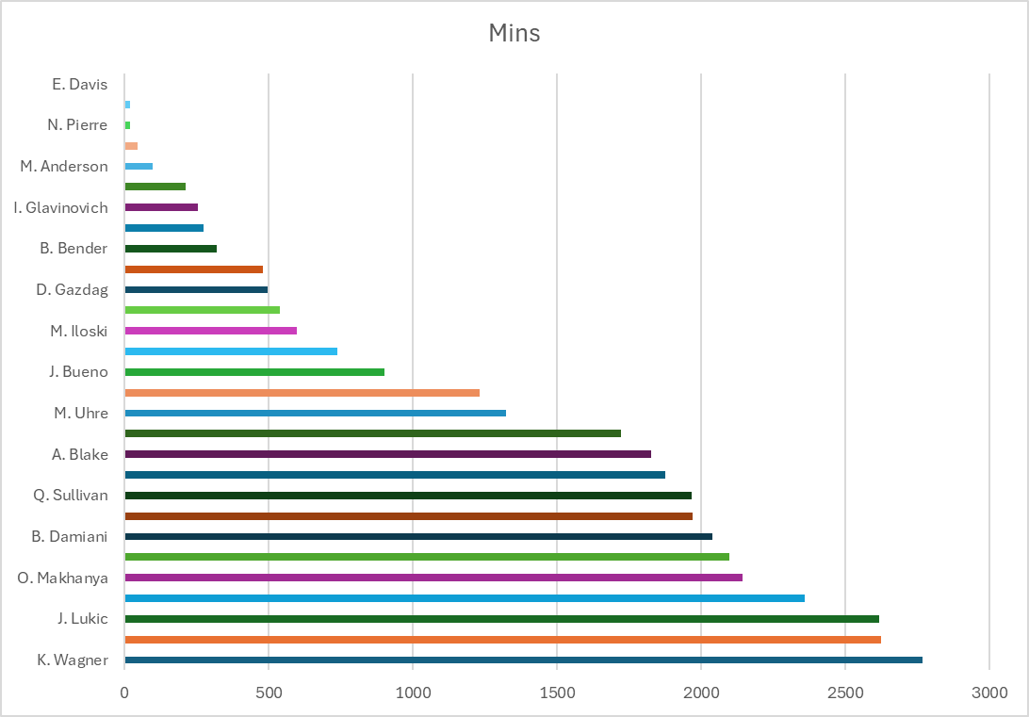
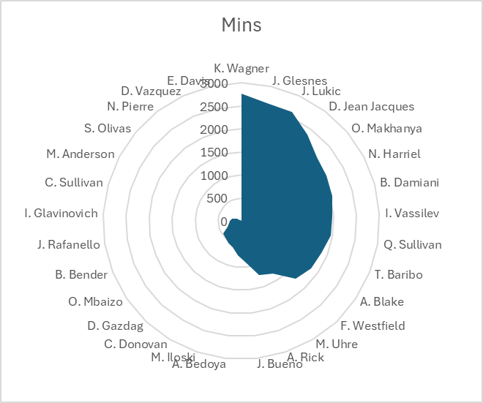
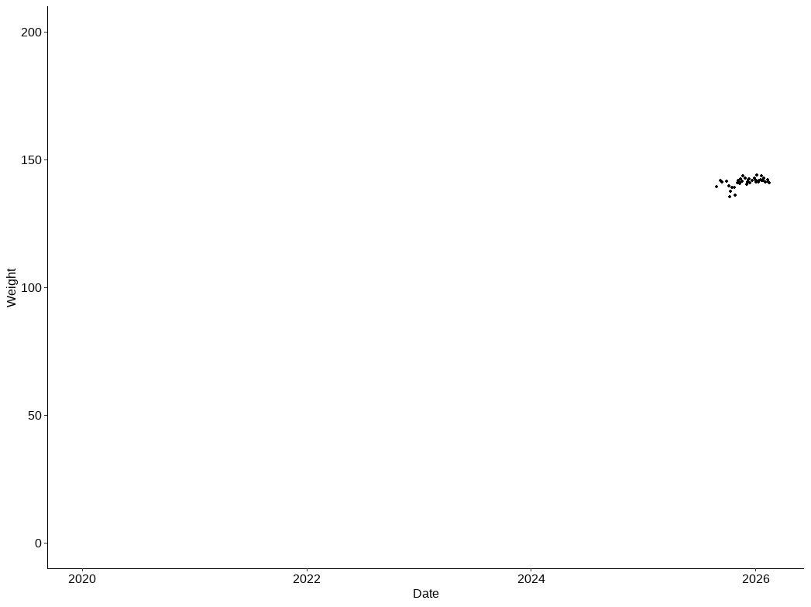
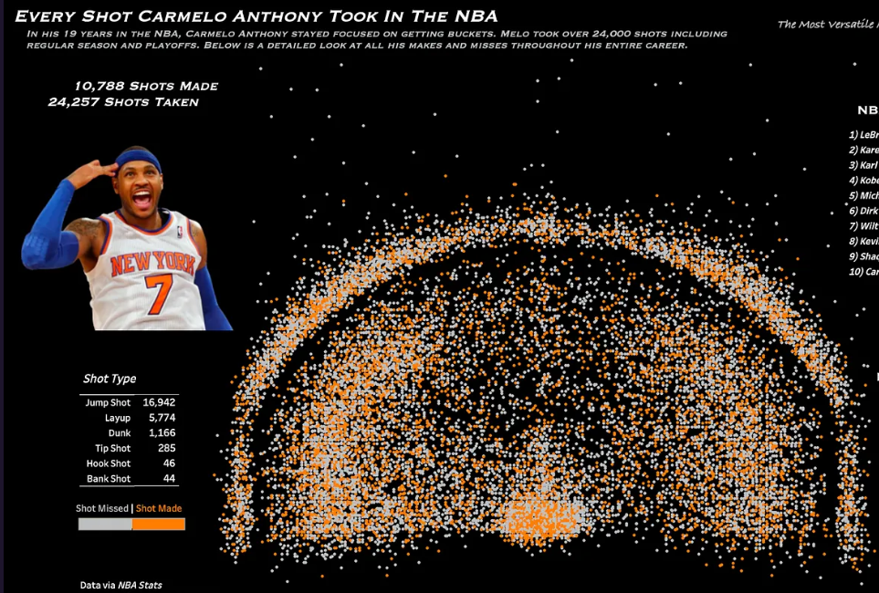
Bad choices

